Slide 1
Delivering ACT in workplace Settings – Adaptations, recommendations & challenges

Slide 2
Disclosures
Disclosure
Dayna Lee-Baggley – separate slide
Nothing to disclose
Helen Bolderston
Ross McIntosh
Duncan Gillard
Eric Morris
Olivia Donnelly

Slide 3
The Discussion
Introductions
Setting the scene
Populations
Data
Discussion
Key themes – adaptations, recommendations & challenges

Slide 4
Discussion
Approval & funding
Marketing
Adapting & flexing
Trainers
Participants Measures

Slide 5
Ross McIntosh
Paul Flaxman & Joe Oliver – ACT for Workplace Well-being
Different populations
Teachers
Civil Servants
NHS
Private sector – including banking
Ballet companies

Slide 6
Dr Helen Bolderston Senior lecturer/clinical psychologist The Bournemouth Adverse Events Research Team
www.surgeonwellbeing.co.uk
Notes:
Number of pieces of work:
National survey of surgeons – the impact of adverse events – complications and errors in their work – but also general stress, burnout, resilience etc.
N = about 500
They’ve got higher levels of distress and burnout than the general population, but lower levels of resilience
They do extraordinarily challenging jobs—but with ordinary resilience
Toolkit will also help advise trusts and MDs to support and give guidance to surgeons following adverse events
Our intention is to find ways to use our findings to influence policy and practice. Its not just about surgeons and their wellbeing, it is also about the context in which they work – we can influence organisations and policies more broadly.
Continuing survey?
Piloting brief coaching intervention – address processes that are implicated in development and maintenance of a range of mental health diagnoses
First aid tool kit – includes guidance for medical directors/hospitals
Influence policy

Slide 7
ACT-Based Resilience Training for Surgeons
Stephen Richer’s PhD
Adapted from The Mindful and Effective Employee, Flaxman, Bond & Livheim (2013)
Pilot/feasibility study
10 trainee surgeons from local UK hospitals
3 x 2 hour 1-to-1 sessions approximately 2 weeks apart

Slide 8
Pilot study outcomes
Brief Resilience Scale
Significant improvements in:
Resilience
Burnout
DASS
Psychological Flexibility
Self-compassion
Valued Living
No significant change in GHQ-12
Multi-site N = 100 RCT on-going

Slide 9
Dr Duncan Gillard
Where delivered?
Bristol and Southern England, mainly in schools
To whom?
14 school cohorts
1 x cohort of school SLT members
1 x cohort of city council directors
3 x cohorts of Educational Psychologists

Slide 10
ACT for Teachers

Slide 11
ACT for Teachers

Slide 12
ACT for Teachers

Slide 13
Head Teacher Thematic Analysis
Themes and sub-themes from thematic analysis of the semi-structured interview transcripts.
Main themes | Sub-themes
Impact upon well-being Comments on psychological flexibility Other significant aspects Practical feasibility | Increased awareness of own well-being Increased awareness of others’ well-being The intention to address well-being Values Being present in the moment Acceptance of difficult thoughts and emotions Committed actions Cognitive defusion Valuing peer interactions Permission to consider well-being Adaptability and flexibility of the training A forum to consider well-being Positive relationships with the trainers Difficulties encountered with the programme Possibilities for the future

Slide 14
Dr. Dayna Lee-Baggley
Registered Psychologist
Behaviour Change Research Institute

Slide 15
Speaker Disclosure
FACILITATOR’s NAME And Credentials | Dayna Lee-Baggley, Ph.D., R.Psych
Relationships with financial sponsors
CONSULTING FEES/ ADVISORY BOARD MEMBER: | Tobacco Free Nova Scotia – clinical advisory committee (honoraria) Bausch Health – scientific advisory committee (honoraria, speaking fees)
SPEAKERS BUREAU/HONORARIA: | Canadian Spondylitis Association (Consulting fees/ honoraria) HeadCan (consultation fees) New Harbinger Publications (royalties) CPD Network Association (speaking fees)
GRANTS/RESEARCH SUPPORT: | Research grants: Kidney Foundation of Canada; QEII Foundation; CIHR; SSHRC
This program has received no financial or in-kind support from any commercial or other organization.
Notes:
Speaker notes:
This slide must be visually presented to the audience AND verbalized by the speaker.
All financial or in-kind relationships with for- and not-for-profit organizations (not only those relevant to the subject being discussed) encompassing the two (2) years up to and including the current presentation, must be declared and disclosed. This applies to all scientific planning committee members, speakers, moderators, facilitators, and authors.

Slide 16
BCI Curriculum: Role of the HCP in chronic disease management
Change-Based Relationships
Getting to Behaviour
Principles
Behaviour Modification
Psychosocial Determinants of Behaviour
Source: Vallis, Lee-Baggley et al., 2018

Slide 17
Professional Resiliency
Notes:
Significant effect of Time (group*time p = .072)
Time and Group*Time significant for Performance
Absenteeism not significant

Slide 18
Knowledge is not enough: Readiness Program
Acceptance and Commitment Therapy
Empirically based behaviour change interventions for the workplace adapted for healthcare
Values: what’s in it for the healthcare provider to change; how will it help you be the healthcare provider you want to be
“Distress tolerance”: tolerating the stress of change; coping strategy to be the expert; willing to be uncomfortable

Slide 19
Daily behavioural outcomes
Daily Tracking Survey:
Q1: Today I used motivation communication (ask, listen, summarize and/or invite)
Q2: Today I used non-judgemental curiosity
Q3: Today I used a readiness assessment
Q4: Today I used a green light intervention (e.g. SMART goal getting, shaping)
Scale for Qs 1-6:
1=never/not at all
2=with one or two patients
3=with several patients
4=with most patients
5=with all patients

Slide 20
Single Case Experimental Design

Slide 21
Delivering ACT for Wellbeing and Resilience training in an acute medical hospital
Dr Olivia Donnelly - Consultant Clinical Psychologist - Lead for Staff Wellbeing Psychology Service
James Warren - Assistant Psychologist
With thanks to Paul Flaxman & Ross McIntosh, and our colleagues at North Bristol NHS Trust and the Southmead Hospital Charity

Slide 22
Pre x Post | T(79) = -7.46, p < 0.001*
Pre x F/U | T(17) = -2.36, p = 0.031*
Post x F/U | T(18) = 2.33, p = 0.031**
Progress
Pre x Post | T(80) = 6.77, p < 0.001*
Pre x F/U | T(17) = 3.22, p = 0.005*
Post x F/U | T(18) = -0.71, p = 0.484
Obstruction
Course/Workshop ACT with Mindfulness | n (pre) | n (post) | n (f/u)
3 sessions (Phase 1) | 33 | 25 | n/a
3 sessions (Phase 2 -3 | 99 | 83 | 17
Day course | 15 | n/a | 8
Total | 147 | 108 | 25
PRE
POST
*‘Caseness’ ≥ score 3
Pre x Post | T(80) = -6.23, p < 0.001*
Pre x F/U | T(16) = -2.71, p = 0.016*
Post x F/U | T(17) = -1.70 p = 0.11
Pre x Post | Post x F/U | Pre x F/U
T(79) = 9.14, p = < 0.001 | T(16) = -.97, p = 0.356 | T(15) = 3.63, p = 0.002
Total Score

Slide 23
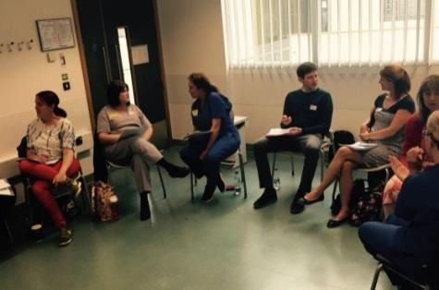
‘Session 2 was a revelation, realising why thoughts appear, how they relate to my values’
‘Take time out to reflect on life. See what my values are’
‘Learning about values based action and how to act out the life I want to’
Themes:
Impact on individual:
Developing awareness and understanding of internal experience
ACT based skills e.g. Values-based action, mindfulness skills, ABC, Vitamin G
Prioritising self-care / kindness
Appreciate thoughts are just thoughts and they don't define you
‘Its ok to take time out if I get overwhelmed at work to breathe and re-focus.
’I liked the way the course leaders joined in with their own experiences and feelings so the atmosphere was made more intimate and friendly
‘’A mindset change – to pause / to be mindful / take note of how I feel and what my body is telling me’
Remember I am valued by NBT enough to allow me to do this.
Be kinder to myself, and show more gratitude to my supporters

Slide 24
‘Session 2 was a revelation, realising why thoughts appear, how they relate to my values’
‘Take time out to reflect on life. See what my values are’
‘Learning about values based action and how to act out the life I want to’
‘Remembering we are all humans with complex emotions’
Themes:
Impact on individual:
Developing awareness and understanding of internal experience
ACT based skills e.g. Values-based action, mindfulness skills, ABC, Vitamin G
Prioritising self-care / kindness
.
Appreciate thoughts are just thoughts and they don't define you
‘Being listened to and not judged by the way I have been feeling recently’
‘Its ok to take time out if I get overwhelmed at work to breathe and re-focus.
’I liked the way the course leaders joined in with their own experiences and feelings so the atmosphere was made more intimate and friendly
Wider Impact:
Common Humanity (painful experiences are part of the universal human experience)
Feeling supported & validated –by facilitators, other members of the group, and more widely
Feeling as if others could benefit from the course
‘Very safe open space. Grateful for everyone's honesty and compassion. Grateful for the facilitators honesty.’
‘’A mindset change – to pause / to be mindful / take note of how I feel and what my body is telling me’
Remember I am valued by NBT enough to allow me to do this.
Be kinder to myself, and show more gratitude to my supporters
‘All staff would benefit from this course both personally and professionally’ ‘for their own personal wellbeing and improving patient experience’

Slide 25
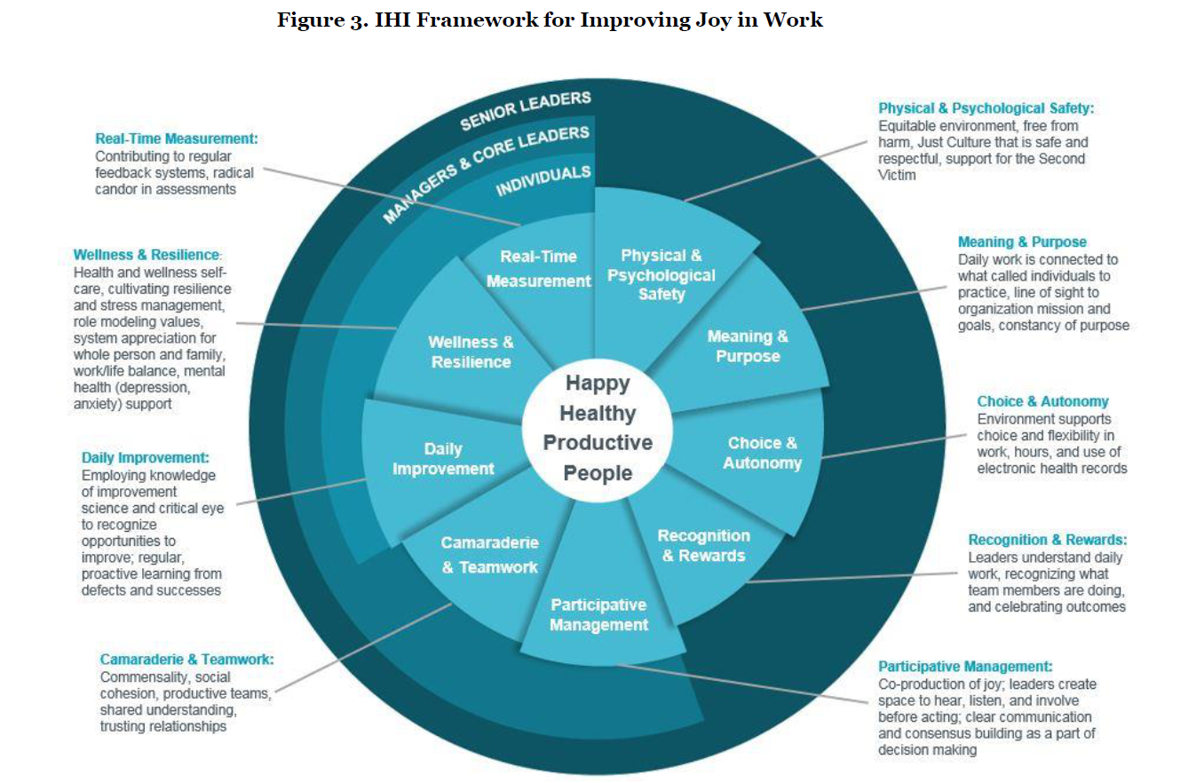
(Perlo J, Balik B, Swensen S, Kabcenell A, Landsman J, Feeley D. IHI Framework for Improving Joy in Work. IHI White Paper. Cambridge, Massachusetts: Institute for Healthcare Improvement; 2017.)

Slide 26
ACT on Purpose
Dr Eric Morris, La Trobe University Psychology Clinic
Offered to La Trobe University staff as part of the Staff Wellbeing initiative (2016 onward)
Run by Provisional Psychologists (trainees) and the Clinic Director (EM)
3+1 Acceptance & Commitment Training format
Based on Flaxman, Bond & Livheim (2013) protocol
Ongoing service evaluation through the LTU Psychology Clinic

Slide 27
ACT on Purpose
2016 – 2019 : 110 participants completed pre, post or a combination of outcome measurement (from 17 groups)
Respondents: 92 female, 16 male, 2 undisclosed gender
Nearly all Professional & Administration staff, very few academics participating
Evaluation, pre- and post-groups:
Wellbeing – General Health Questionnaire-12
Psychological flexibility – Workplace Acceptance & Action Questionnaire
Mindfulness – Mindful Attention & Awareness Scale

Slide 28
ACT on Purpose
Pairwise comparisons, pre- and post-group
Outcome | Measure | N | Mean (SD) | t-test sig | Effect Size (d_{z})
Wellbeing | GHQ-12 Pre | 49 | 5.00 (4.56)
 | GHQ-12 Post | 49 | 3.89 (3.90) | .001 | 0.49
Psychological flexibility | WAAQ Pre | 57 | 31.75 (6.27)
 | WAAQ Post | 57 | 34.85 (5.25) | .001 | 0.52
Mindfulness | MAAS Pre | 54 | 3.65 (.83)
 | MAAS Post | 54 | 3.92 (.69) | .001 | 0.52

Slide 29
ACT on Purpose
Post workshop feedback – 0 -10 ratings
Question | N | Mean | SD
Were your expectations met? | 58 | 8.2 | 1.4
I feel confident I can apply what I learned from the workshops | 58 | 8.6 | 1.2
The material was presented in a way that was easy to understand | 58 | 9.0 | 1.3
Did you find the facilitators helpful? | 58 | 9.4 | 0.9
Would you recommend the workshops to your work colleagues? | 58 | 9.3 | 1.3
Overall, how do you rate the quality of the workshops? | 58 | 9.2 | 1.3

Slide 30
Discussion

Slide 31
Approval & funding
Convincers
Permissions

Slide 32
Marketing to participants
What works?
Title – words that work
Taster sessions

Slide 33
Adapting & flexing
Content
Delivery structure
Integrating into organisational approach

Slide 34
The trainers
Experience
Training
Co-delivery
Supervision

Slide 35
Participants
Themes
Experience
Ongoing support
Refreshing

Slide 36
Contacts
Helen Bolderston - hbolderston@bournemouth.ac.uk
Duncan Gillard – duncan.gillard@bristol.gov.uk
Dayna Lee-Baggley – dayna.lee-baggley@dal.ca
Olivia Donnelly – olivia.donnelly@nbt.nhs.uk
Eric Morris – eric.morris@latrobe.edu.au
Ross McIntosh – ross.mcintosh@city.ac.uk

Slide 37
Annex: Definition mentioned in discussion from Taslim Tharani

Slide 38
What does it mean to be resilient during times of change?
Ability to remain productive and effective during adversity/disruptive change
Resilient people
‘Bounce back’ – recover more quickly from physical and psychological stress
Apply their energy more effectively
© Taslim Tharani, 2019, request permission before use
Notes:
In the modern world – change happens at an incredibly fast pace – with new technology, globalisation, jobs now that didn’t even exist 5 years ago! In fact – Buddhist idea of impermanence – we are constantly changing
‘Resilience is the ability to absorb high levels of disruptive change while displaying low levels of unproductive behaviour’ – unproductive behaviour – not engaging, shutting down, stirring the pot, human behaviour – disruptive change – want to minimise the unproductive behaviour
Resilient people apply energy more effectively – helps them to adapt to change.
Cope effectively with stress and uncertainty
Bounce back from physical and psychological stress i.e. they recover from stress more quickly
Absorb high levels of change and remain effective
Adjust to disruption in life
Maintain high levels of productivity
Recover more quickly and more effectively!! – takes more to disrupt, less unproductive behaviour, quicker recovery

Slide 39
Developing psychological flexibility
Resilient people focus their ENERGY on behavioural effectiveness and productivity
They FOCUS on what they CAN change/influence
They open up to a range of POSSIBILITIES – they develop FLEXIBILITY
They have a SENSE OF PURPOSE
They focus on the LONG TERM rather than immediate gratification
© Taslim Tharani, 2019, request permission before use

